Slide 1
Statistics and Reliability: Module 11
Sample Size
Notes:
Module Topics
Sample Size Basics:
Define and distinguish between statistical and practical significance and apply tests for significance level, power, type I and type II errors.
Determine appropriate sample size for various tests, e.g.
1-Sample Hypothesis Test Sample Size Determination
Copyright (c) Deere & Company, as an unpublished work. This material is the property of Deere & Company. All use, disclosure, and/or reproduction not specifically authorized by Deere & Company is prohibited.

Slide 2
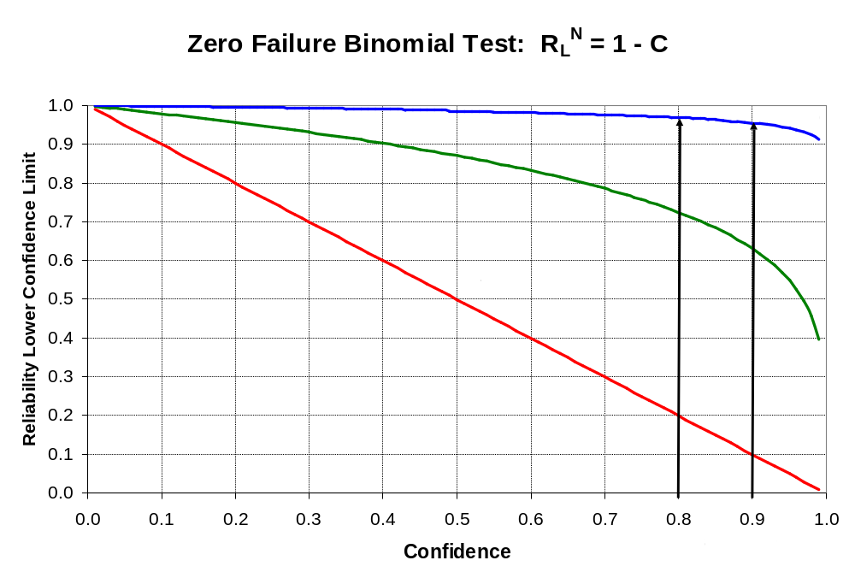
Notes:
Scenario: Test N parts and none fail. If we try to estimate the reliability, we get 100% because N/N = 1. But we could have just gotten lucky (and sometimes it’s better to be lucky than good). We can, however, estimate the lower confidence limit for reliability using the formula “R_{L}^{N} = 1 – C” (for more than 0 failures, the formula uses a Chi-squared distribution value).
Think of Reliability as the probability of success or the proportion of good parts.
Confidence and Reliability have an inverse relationship, e.g.
for N = 1, as Confidence increases from C₁ = 0.8 to C₂ = 0.9, the lower confidence limit for reliability decreases from R₁ = 0.20 to R₂= 0.10;
for N = 5, as Confidence increases from C₁ = 0.8 to C₂ = 0.9, the lower confidence limit for reliability decreases from R₁ = 0.72 to R₂= 0.63;
for N = 50, as Confidence increases from C₁ = 0.8 to C₂ = 0.9, the lower confidence limit for reliability decreases from R₁ = 0.97 to R₂= 0.95.
Need to find the value of N that provides the combination of C and R that you desire.

Slide 3
Statistical Hypothesis Testing
Sampling Distribution
Level of Confidence
Rejection Region
1 - α
Non-rejection
α
Region
H₀
Sample Statistic
Value
Critical Value
Notes:
Decision Making
Statistics teaches that there are two risks to every decision. The goal is to establish objective decision criteria that minimize these risks. Examples:
Statistical Hypothesis Testing
USA Legal System
Product Testing
Hypothesis: a tentative assumption made in order to test a theory to its logical or empirical conclusion
Null Hypothesis (H₀): the statement being tested, e.g.
H₀: p < 0.02
Alternative Hypothesis (H₁): the converse of the null hypothesis, e.g.
H₁: p > 0.02

Slide 4
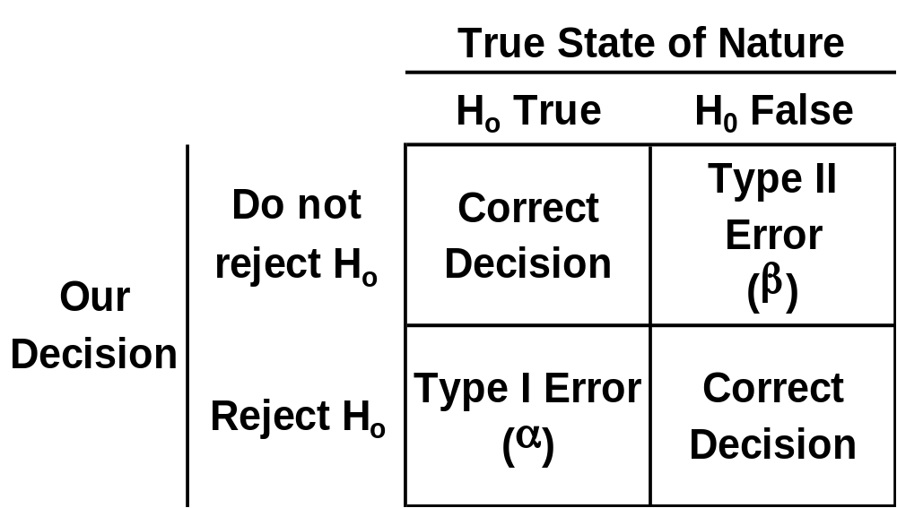
Statistical Hypothesis Testing
Notes:
H₀ is either
“True”, e.g. the actual p is < 0.02; or
“False”, e.g. the actual p is > 0.02
There are two “correct” decisions one can make:
Fail to reject H₀ when it is True; or
Reject H₀ when it is False
There are two “errors” one can make:
Fail to reject H₀ when it is False; or
Reject H₀ when it is True
Type I Error
Reject a true null hypothesis
P(Reject H₀ | H₀ True ) = α
Also know as “level of significance”
Type II Error
Fail to reject a false null hypothesis
P(Fail to reject H₀ | H₀ False) = β

Slide 5
USA Legal System Risks
Assume Innocent until proven Guilty
Jury Trial
Actual Situation
Innocent
Guilty
Not
guilty
Type II Error
Correct
Verdict
Type I Error
Guilty
Correct
Notes:
USA legal system assumes innocent until proven guilty:
H₀: Innocent versus H₁: Guilty
This system is designed to free guilty people (Type II error > 0, remember O.J. Simpson?) more often than convicting innocent people (Type I error > 0).

Slide 6
USA Legal System Risks versus Hypothesis Testing
Assume Innocent until proven Guilty
Assume H₀ is True until proven False
Jury Trial
Hypothesis Test
Actual Situation
Actual Situation
Innocent
Guilty
H₀
H
0
Verdict
Decision
True
False
Do not
Type II
Not
guilty
Correct
Type II Error
reject
1 -
α
Error
H
0
(
β
)
Type I
Type I Error
Reject
Power
Guilty
Correct
Error (
α
)
H
(1 -
β
)
0
Notes:
Hopefully you can see the analogies between the USA Legal System and the Hypothesis Testing we covered earlier.
In the USA Legal System, sometimes guilty people go free and sometimes innocent people get the Death Sentence. Even with all the criteria for “beyond a reasonable doubt” and the mandatory appeal process, DNA testing showed many convicted of a capital offence were in fact innocent. That’s why the last Governor of Illinois, George Ryan, commuted the sentence of 164 death row inmates [see Ultimate Punishment: A Lawyer's Reflections on Dealing with the Death Penalty by Scott Turow].
Think about this when you perform hypothesis testing on your job. Are you really sure of anything?
Remember: “Statistics means never having to say you’re certain.”

Slide 7
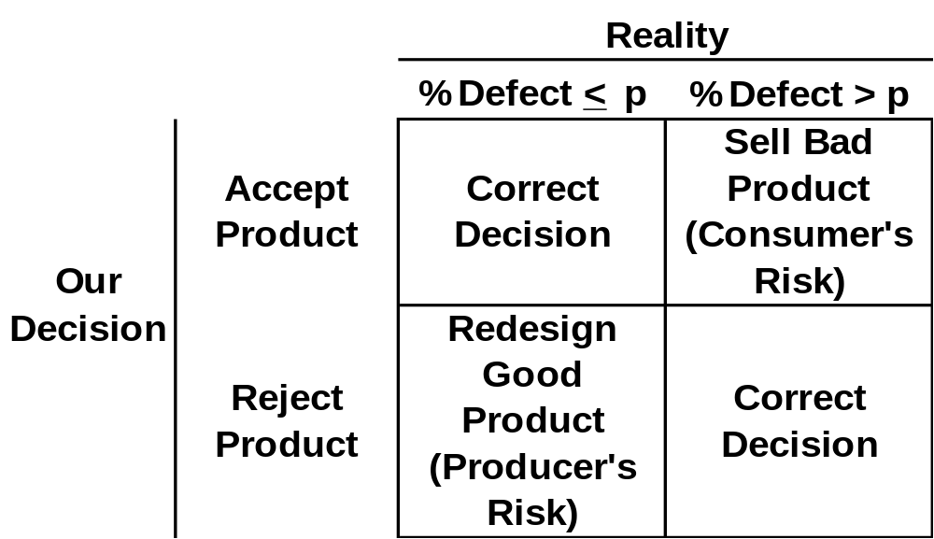
Product Testing Risks
Notes:
Producer’s Risk (α)
Probability of rejecting a “good” product
P(Reject H₀ | H₀ True ) = α
Implies redesigning a “good” product
Consumer’s Risk (β)
Probability of accepting a “bad” product
P(Fail to reject H₀ | H₀ False) = β
Implies selling a “bad” product to consumers

Slide 8
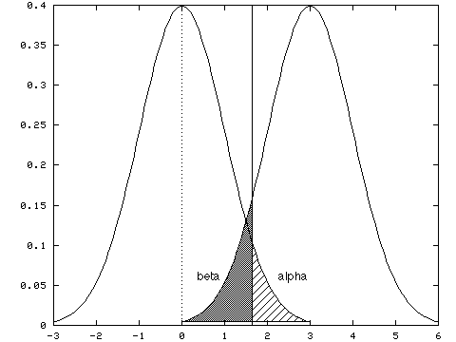
α and β Have an Inverse Relationship
Notes:
Since α and β have an inverse relationship – as one goes up, the other goes down - you can’t reduce both errors simultaneously (for a fixed sample size).
Choosing Probability Levels α and β
Severity of making an error: The more serious the error, the less often you will be willing to allow it to occur. Therefore, you should assign smaller probability values to more serious errors.
Magnitude of effect you want to detect: Power is the probability (= 1 - β) of correctly rejecting H₀ when it is false. Ideally, you want to have high power to detect a difference that you care about, and low power for a meaningless difference.
Factors That Influence Power
Probability of a Type I error (α): As a increases, the probability of a Type II error (β) decreases and Power = 1 – β increases
Variability in the population (σ): As σ increases, Power decreases
Size of the population difference (effect): As the effect decreases, Power decreases
Sample size n: As n increases, Power increases

Slide 9
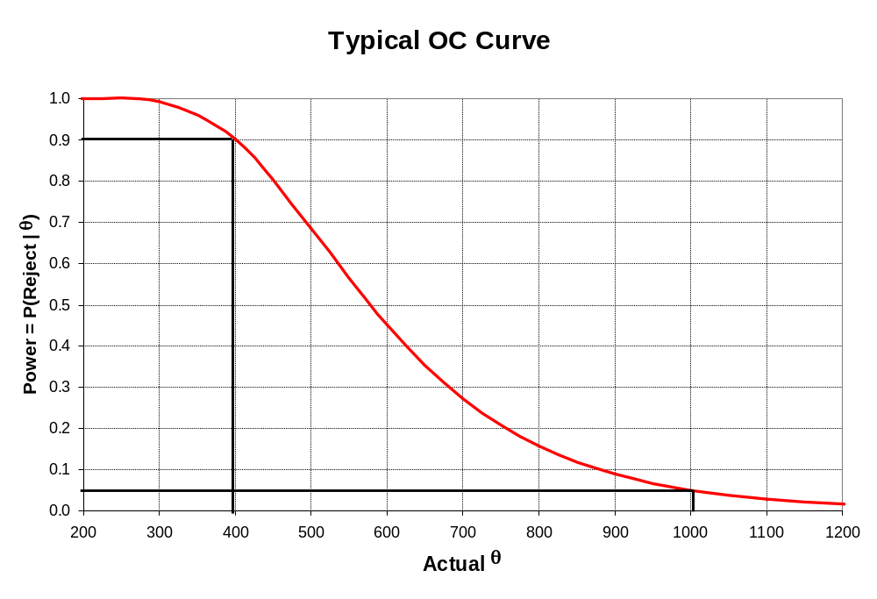
Notes:
Test Operating Characteristics
Once a test is defined, its “Operating Characteristics” should be examined
How good it is at determining whether H₀ is True or False
Depict graphically with an Operating Characteristic (OC) Curve
Summarizes the risks of a test plan
Aids in selecting a test plan

Slide 10
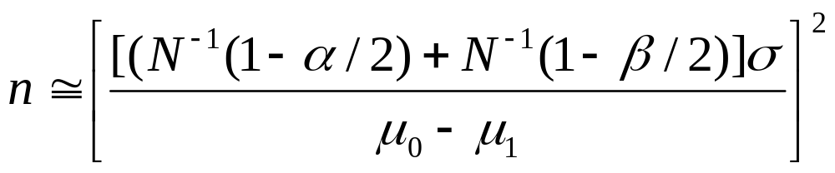
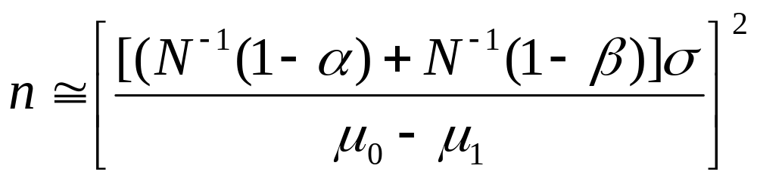
Normal Test Plans
Two-sided Test:
One-sided Test:
Notes:
Test Planning Steps
State null hypothesis (H₀)
State alternative hypothesis (H₁)
Select Producer’s Risk (α)
Select Consumer’s Risk (β)
Calculate the sample size required to reach a decision about H₀ that satisfies α and β
Use above formulas for complete samples that follow the normal distribution.
Need a “guesstimate” of the standard deviation!
Recall the confidence interval for standard deviation?

Slide 11
Recall: Standard Normal CDF Notation
Value (x)
N(x)
Probability (p)
INORMAL(x, 0, 1)
Probability (p)
N⁻¹(p)
Value (x)
VNORMAL(p, 0, 1)
Notes:
N⁻¹(p) is the inverse of the standard normal Cumulative Distribution Function (CDF) that we discussed at the beginning of this course.
Use Statistica’s Probability Distribution Calculator to find the values.

Slide 12
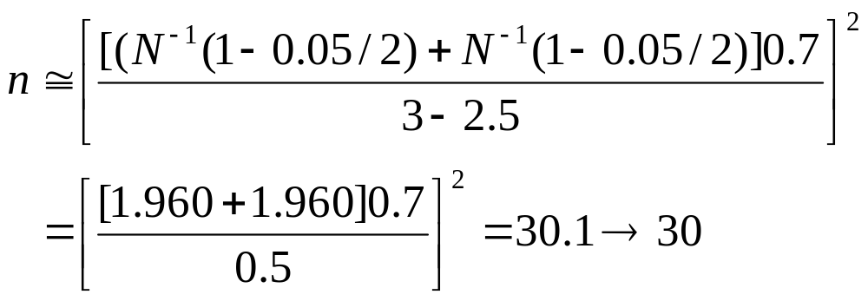
Two-sided Test Example
Notes:
H₀: μ = 3 years vs. H₁: μ ≠ 3 years
Believe σ = 0.7 years
Want α = 0.05
Willing to accept μ₁ = 3 + 0.5 years with β = 0.05

Slide 13
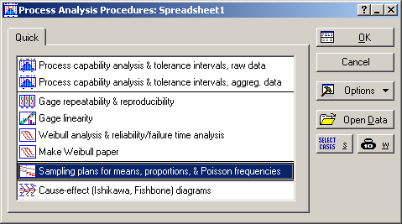
Notes:
Statistica Analysis
Statistics > Industrial Statistics & Six Sigma > Process Analysis > Sampling plans for means, proportions, & Poisson frequencies

Slide 14
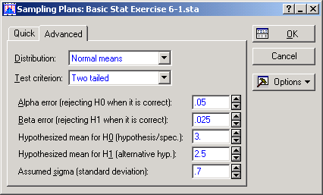
- Note
Notes:
Select the options above and enter the parameters shown on the Advanced tab:
Distribution = Normal means
Test criterion = Two tailed
Alpha error = 0.05
Beta error = 0.025 (Note: for a two-sided test, use 0.05/2 for this menu)
Hypothesized mean for H0 = 3.0
Hypothesized mean for H1 = 2.5
Assumed sigma = 0.7
Then click “OK.”

Slide 15
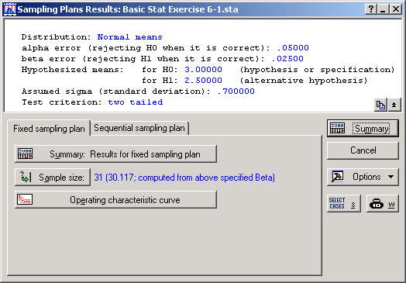
Notes:
The calculated sample size is 30.117, the same as the formula shown previously, but Statistica rounded up to 31, not down to 30.
Click the “Operation characteristic curve” button.

Slide 16
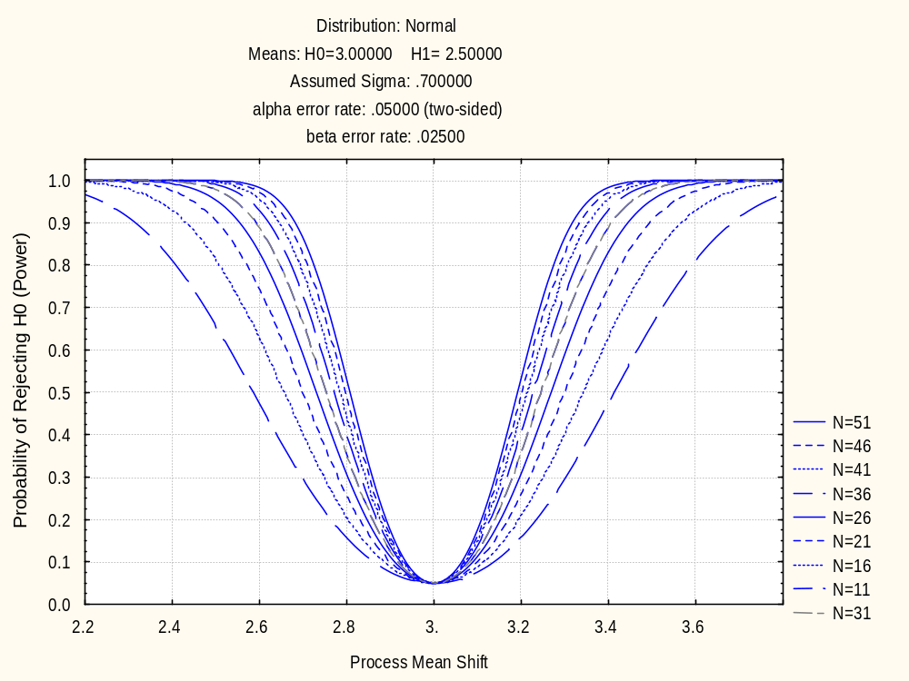
β/2 = 0.025
α = 0.05
Notes:
Statistica’s OC curve confirms we achieved our desired error rates with a sample size of 31 (30 would have been very close too).
It also shows how the error rates would have changed for a range of sample sizes.

Slide 17
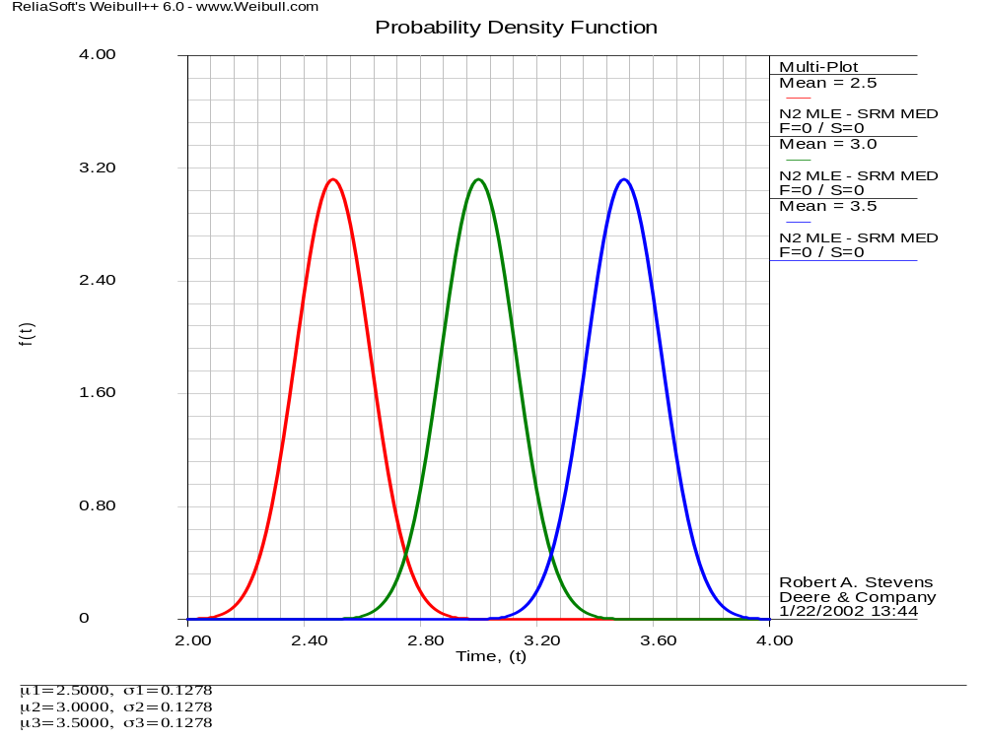
LCL = 2.75
UCL = 3.25
μ = 2.5
μ = 3.0
μ = 3.5
α/2 = 0.025
β/2 = 0.025
α/2 = 0.025
Notes:
This graphic was made using Weibull++ (and you are not expected to do the same).
The intention is to graphically show how the error rates relate to the areas in the tails of the confidence intervals for the null and alternative hypotheses values.
Since we looked in two directions – the lower side and the upper side – there are two alternative hypothesis confidence intervals.

Slide 18
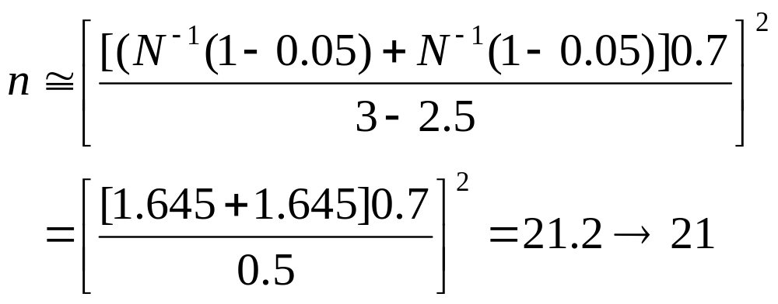
One-sided Test Example
Notes:
H₀: μ > 3 years vs. H₁: μ < 3 years
Believe σ = 0.7 years
Want α = 0.05
Willing to accept μ₁ = 2.5 years with β = 0.05

Slide 19
Notes:
Statistica Analysis
Statistics > Industrial Statistics & Six Sigma > Process Analysis > Sampling plans for means, proportions, & Poisson frequencies

Slide 20
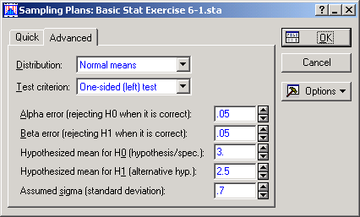
Notes:
Select the options above and enter the parameters shown on the Advanced tab:
Distribution = Normal means
Test criterion = One-sided (left) test
Alpha error = 0.05
Beta error = 0.05
Hypothesized mean for H0 = 3.0
Hypothesized mean for H1 = 2.5
Assumed sigma = 0.7
Then click “OK.”

Slide 21
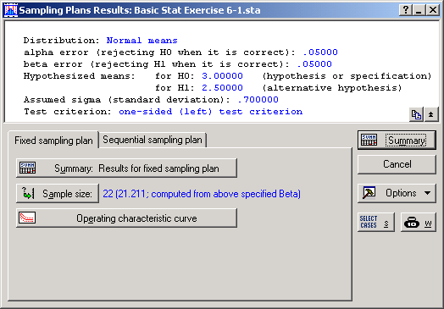
Notes:
The calculated sample size is 21.211, the same as the formula shown previously, but Statistica rounded up to 22, not down to 21.
Click the “Operation characteristic curve” button.

Slide 22
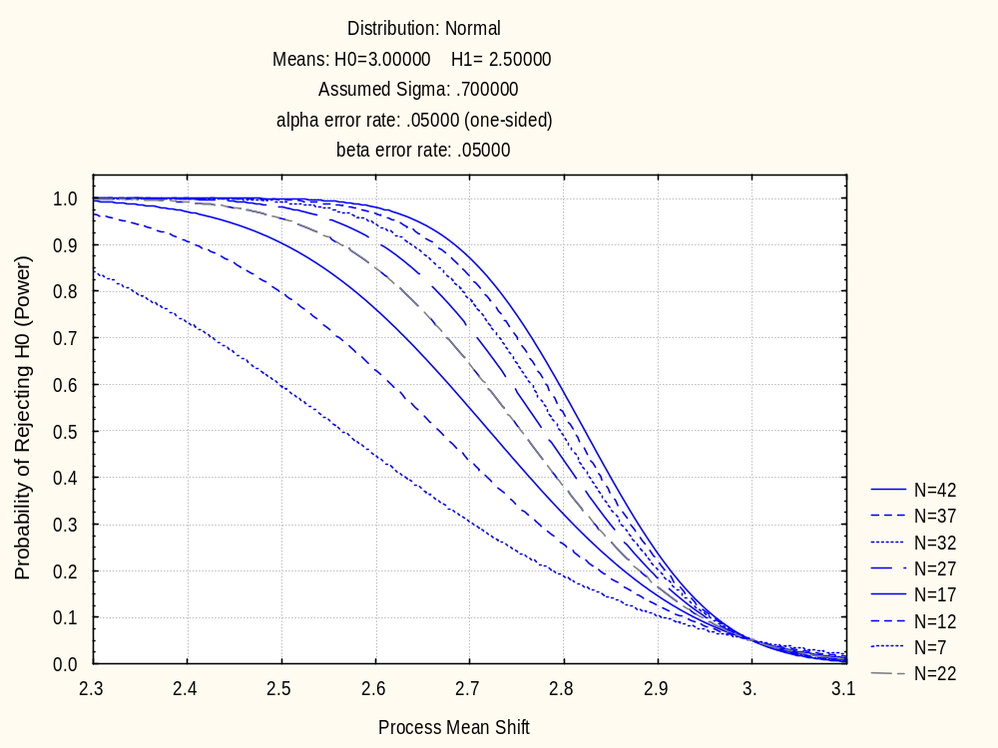
β = 0.05
α = 0.05
Notes:
Statistica’s OC curve confirms we achieved our desired error rates with a sample size of 22 (21 would have been very close too).
It also shows how the error rates would have changed for a range of sample sizes.

Slide 23
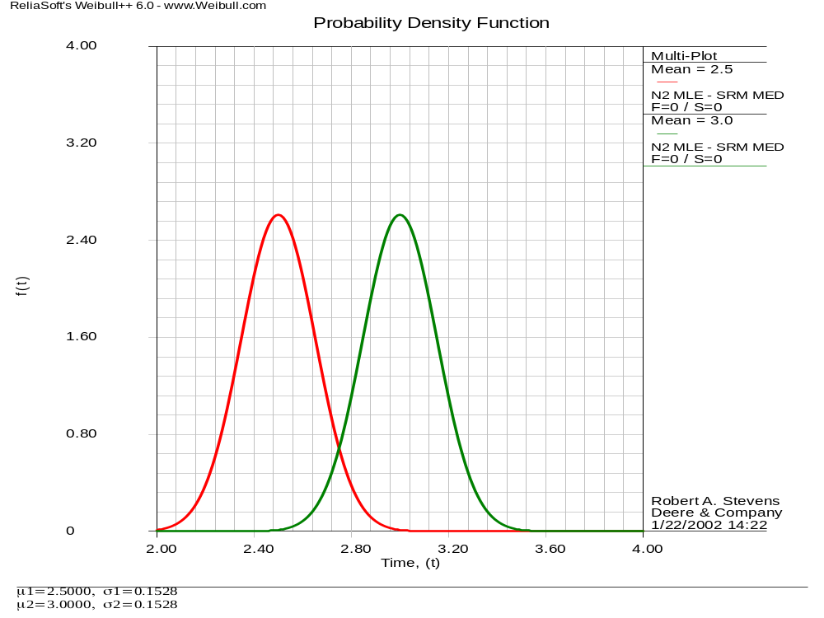
LCL = 2.75
μ = 2.5
μ = 3.0
α = 0.05
β = 0.05
Notes:
Again, this graphic was made using Weibull++ (and, again, you are not expected to do the same).
The intention is to graphically show how the error rates relate to the areas in the tails of the confidence intervals for the null and alternative hypotheses values.
Since we only looked in one direction – the lower side – there is only one alternative hypothesis confidence interval.

Slide 24
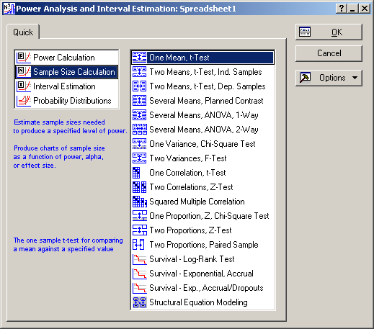
Notes:
Statistics > Power Analysis > Sample Size Calculation
17.3 Example 17.1: Sample Size Determination for a Mean Criterion Test
Page 408: “A stereo amplifier output power level is desired to be on the average at least 100 watts (W) per channel. Determine the sample size that is needed to verify this criterion given the following:
α = 0.10
β = 0.05
δ = 0.05σ [the effect, i.e. magnitude of the difference in means]

Slide 25
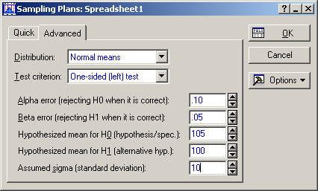
Notes:
First try: Statistics > Industrial Statistics & Six Sigma > Process Analysis > Sampling plans for means, proportions, & Poisson frequencies
Select the options above and enter the parameters shown on the Advanced tab:
Distribution = Normal means
Test criterion = One-sided (left) test
Alpha error = 0.10
Beta error = 0.05
Hypothesized mean for H0 = 105 (so that δ = μ₀ – μ₁ = 5)
Hypothesized mean for H1 = 100 (the minimum acceptable value)
Assumed sigma = 10 (so that δ = 0.5σ)
Then click “OK.”

Slide 26
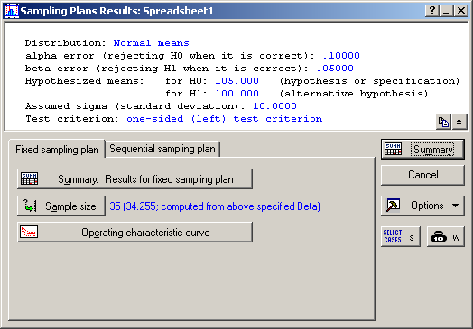
Notes:
Compare to the first formula on page 409. The Sample size numbers match!
This one uses the Normal distribution for the critical values.

Slide 27
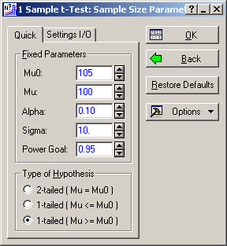
Notes:
Now try: Statistics > Power Analysis > Sample Size Calculation > One Mean, t-test
Select the options above and enter the parameters shown on the Quick tab:
Mu0 = 105 (so that δ = μ₀ – μ₁ = 5)
Mu = 100 (the minimum acceptable value)
Alpha = 0.10
Sigma = 10 (so that δ = 0.5σ)
Power Goal = 0.95 (= 1 - Beta = 1 - 0.05)
Type of Hypothesis = 1-tailed (Mu >= Mu0)
Then click “OK.”

Slide 28
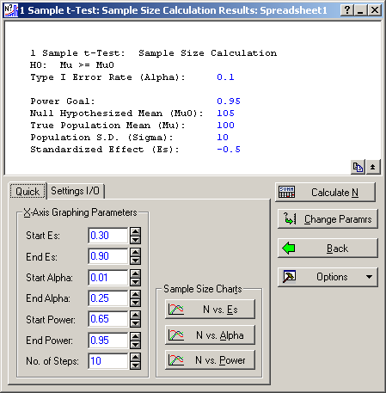
Notes:
Select “Calculate N”

Slide 29
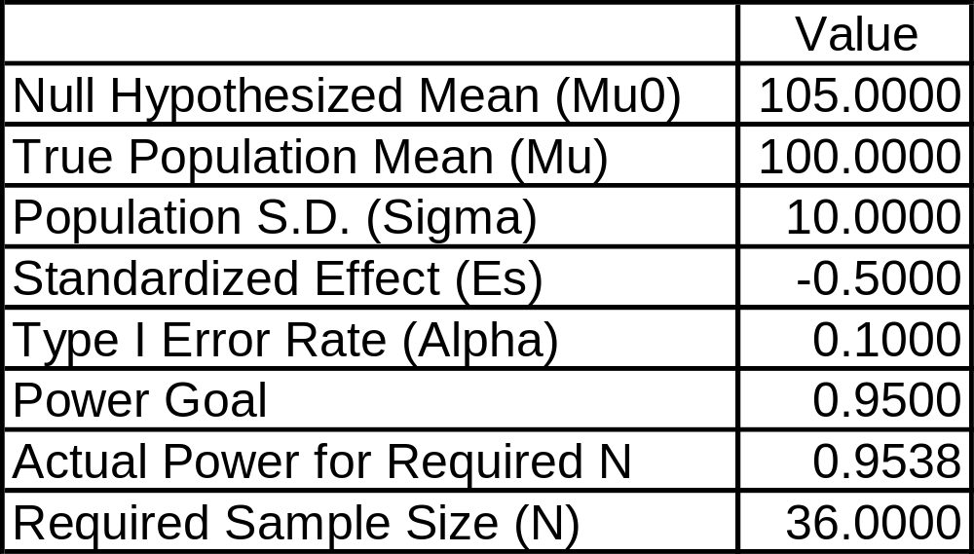
Sample Size Calculation (Spreadsheet1)
One Mean, t-Test
H0: Mu >= Mu0
Notes:
Compare to the second formula on page 409. The Sample Size numbers match!
This one uses the t-distribution for the critical values.

Slide 30
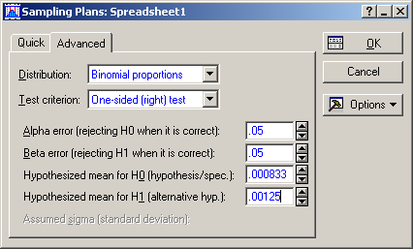
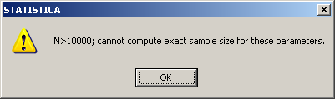
Notes:
18.3 Example 18.1: Sample Size – a Hypothesis Test of an Attribute Criterion
“A supplier manufactures a component that is not to have more than 1 defect every 1000 parts (i.e. a 0.001 failure rate criterion). The want to determine a test sample size for assessing this criterion.”
First try: Statistics > Industrial Statistics & Six Sigma > Process Analysis > Sampling plans for means, proportions, & Poisson frequencies
Select the options above and enter the parameters shown on the Advanced tab:
Distribution = Binomial proportions
Test criterion = One-sided (right) test
Alpha error = 0.05
Beta error = 0.05
Hypothesized mean for H0 = 0.000833
Hypothesized mean for H1 = 0.00125
Then click “OK” and get the error message “N>10000; cannot compute exact sample size for these parameters.” And who is going to get N > 10,000 parts for testing anyway?

Slide 31
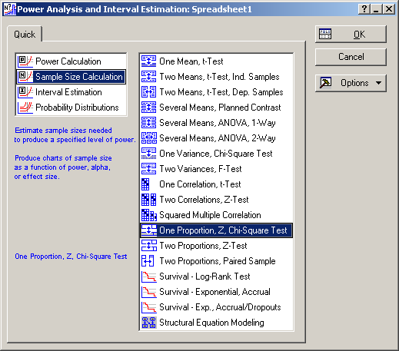
Notes:
Now try:
Statistics > Power Analysis > Sample Size Calculation > One Proportion, Z, Chi-Square Test

Slide 32
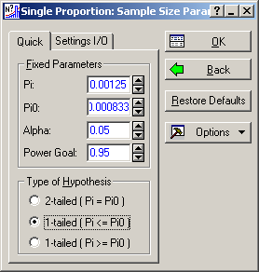
Notes:
Select the options above and enter the parameters shown on the Quick tab:
Pi = 0.00125
Pi0 = 0.000833
Alpha = 0.05
Power Goal = 0.95 (= 1 - Beta = 1 - 0.05)
Type of Hypothesis = 1-tailed (Pi <= Pi0)
Then click “OK.”

Slide 33
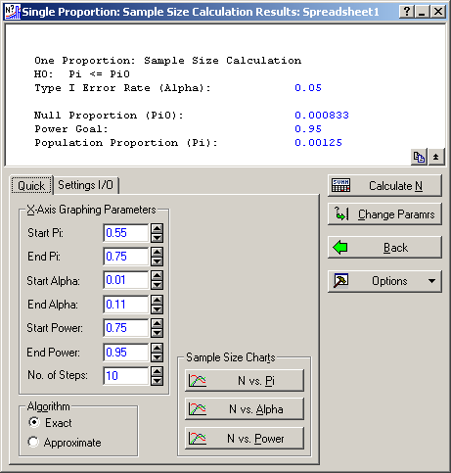
Notes:
Select “Calculate N”

Slide 34
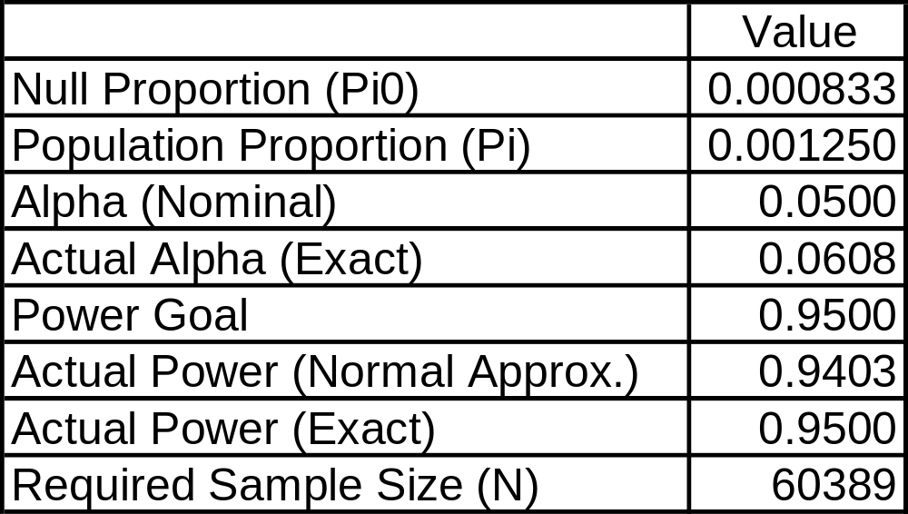
Sample Size Calculation (Spreadsheet1)
One Proportion, Z, Chi-Square Test
H0: Pi <= Pi0
Notes:
Compare to the results on page 428: n = 64,106. That formula used a Normal distribution approximation to the Binomial, as explained the last paragraph of that section. The descriptions in the table above suggest that Statistica is using the exact sample size, not the Normal approximation.
But who cares if the answer is 64,106 or 60,389 – you’ll never get 60,000 parts to test!

Slide 35
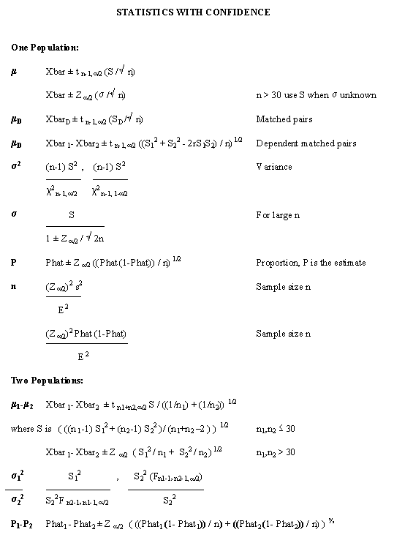
Notes:
http://home.ubalt.edu/ntsbarsh/Business-stat/opre504.htm
Review
Do you know how what the following are:
Type I error (α)?
Type II error (β)?
Power (1 - β)?
Can you determine the sample size required for a 1-sample test for the mean of a normal distribution?

Slide 36
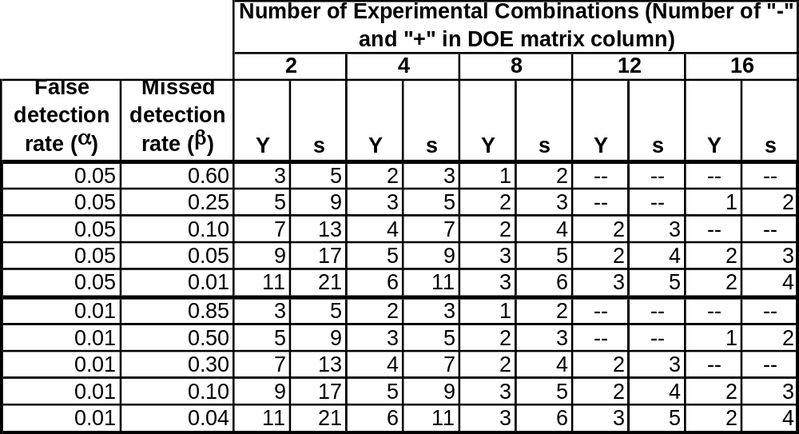
Sample Size per Experimental Condition
(i.e. Number of Replicates)
Notes:
Forrest W. Breyfogle III suggests in his book that you probably only really need (or can afford) 1 replicate per DOE combination. He recommends instead trying to minimize the measurement errors so you can detect differences with small sample sizes. This is being statistically liberal, i.e. more accepting of the risk of not finding anything.
The table above is modified from Understanding Industrial Designed Experiments by Schmidt and Launsby [4th Edition, Appendix M-2], which is a very good book for applied DOE and has several examples from the electronics industry. These authors are statistically conservative, i.e. less accepting of the risk of not finding anything.
The “Y” column provides the necessary number of replicates for an experiment to study the mean of the response, and the “s” column provides the necessary number of replicates for an experiment to study the standard deviation of the response. Note: the “Y” column is half the “s” column, rounded up to the nearest integer, which is one of the rules of thumb Schmidt and Launsby recommend. For example, if the number of factors is 5 and you select a 16-run fractional factorial DOE and want α = 0.05 and β = 0.05, then you would need 3 replicates for a study of the standard deviation of the response but only 2 replicates for a study of the mean of the response.

